Slide 1
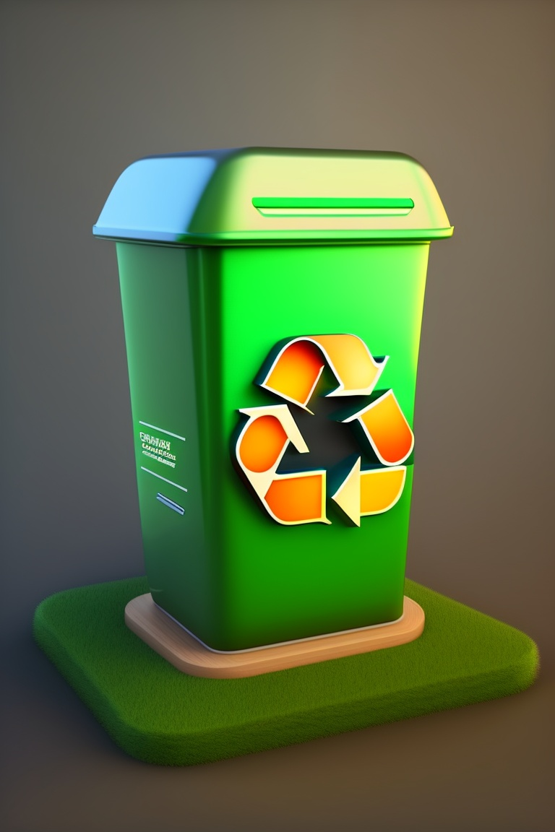
LOGO
Eco
Bins

Slide 2
Code Crafters
Abhinand I: Backend Developer
Minhaj P: Backend Developer
Aadhil Muhammad Abou: Backend and AI Developer
Nitish M S: Frontend and AI Developer
Arjun K: Frontend and AI Developer
Niranjan: Backend and AI Developer
For any inquiries or collaboration opportunities, please reach out to us at codecrafters@gmail.com.
We are a team of passionate developers dedicated to revolutionizing waste management. Our project focuses on integrating sustainability, creativity, and community engagement to transform waste into art and responsible disposal.
Photos.
(Add Github/LinkedIn profile?)

Slide 3
Problem statement
Waste management stands as a pressing global challenge, demanding sustainable solutions to mitigate its environmental and public health impacts. The improper disposal of waste not only inflicts harm upon the environment but also poses significant health risks to communities worldwide. Traditional waste management systems, often characterized by a lack of efficiency and transparency, result in suboptimal outcomes. This includes environmental degradation, compromised public health, and economic burdens.
IMAGE

Slide 4

Our Solution
Creative Content Library:
Showcase user-generated upcycling and waste-to-art projects.
Includes step-by-step guides and connections with creators.
Gamification and Challenges:
Incentivize users with points, badges, or rewards for completing eco-art challenges.
Eco-Conscious Marketplace:
Curated section featuring eco-conscious art pieces.
Supports artists creating meaningful eco-art.
Eco-Certification:
- Sellers provide eco-friendliness evidence for certified items.
Community Engagement and Education:
Regular online workshops and webinars.
User-generated content hub for educational content.
Integration with Local Waste Services:
Real-time route optimization and waste data reporting.

Slide 5
What Sets Us Apart
Ecobins is not just another waste management solution, it represents a paradigm shift in how we view and manage waste. To fully appreciate the impact of Ecobins, it's essential to understand what sets us apart from conventional waste management approaches.
Sustainability Integration:Seamlessly integrates waste management with sustainability and creativity.
Eco-Conscious Marketplace: Offers an integrated auction section and marketplace for eco-conscious art pieces.
Community-Centric: Serves as a hub for reporting waste issues, engaging in educational content, and fostering community involvement.
Collaboration with Local Services: Actively collaborates with local waste services to optimize waste collection routes.
Inclusive Design: Designed with inclusivity in mind, ensuring accessibility for all backgrounds.

Slide 6
Stack
Backend Development: Node.js, Express, Firebase
Frontend Development: React, HTML/CSS, JavaScript
AI/ML: Python, TensorFlow, scikit-learn
Tools: Git, Docker, AWS, Firebase
(Redo with logos, as flow chart?)

Slide 7
Demo Pages (college of home page of each module)

Slide 8
IoT-Enabled Smart Bins
Interactive Mobile App
Advanced Analytics Platform
Environmental Impact Tracker
Goals for Future

Slide 9
Thank You
Code Crafters
codecrafters@gmail.com

